Slide 1
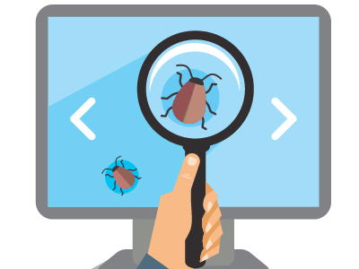
QA Fundamentals
Introduction to Software Development
QA
Fundamentals
SoftUni Team
Technical Trainers
Software University
http://softuni.bg

Slide 2

Table of Contents
What is Software?
Software Distribution Types
Retail software
Web applications
Mobile applications
Why Bugs Still Occur?
Bug Fixing Importance

Slide 3
Have a Question?
sli.do
#TECH-FUND

Slide 4

Software Development

Slide 5







First Look at Software
Education
Business
Industry
Industry
Military
Entertainment

Slide 6
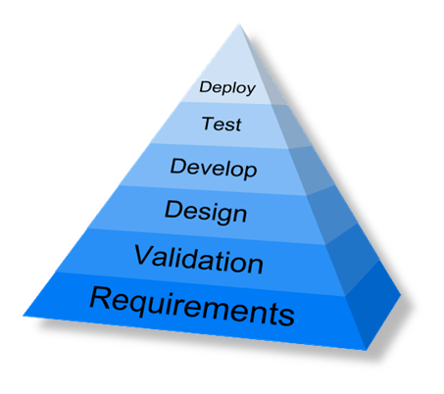
First Look at Software (2)
Developed for 8 decades
Evolved into a profession
Concerned into quality maximizing
Software engineering

Slide 7

First Look at Software (1)
Software Definition
Software is any set of machine-readable instructions that directs a computer's processor to perform specific operations

Slide 8

Types of Software
Software Distribution

Slide 9

Retail Software
The vast majority of software until the emergence of internet

Slide 10


Web Applications
The concept has been introduced in 1999 in Java Servlets
A major leap in the software distribution
Browsers and technologies are developed in favor of web apps
2005 – the term Ajax was coined
2011 – HTML5 was finalized

Slide 11


Mobile Applications
App distribution platforms began appearing in 2008
Apple app store
Google play
Windows phone store
Started as productivity and information retrieval apps
Reached bigger market share than retail software

Slide 12

Bugs!

Slide 13
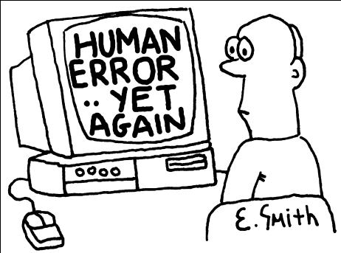
Software Defects
Human being can make an error (mistake)
Errors produce defects
Defects are faults / bugs in the program code, or in a document
If a defect in code is executed, that might cause a failure:
Fail to do what it should do
Do something it shouldn’t

Slide 14

Software Defects
The human factor
Humans make mistakes
Poor training
Time pressure
Code complexity
Complexity of infrastructure
Changing technologies

Slide 15
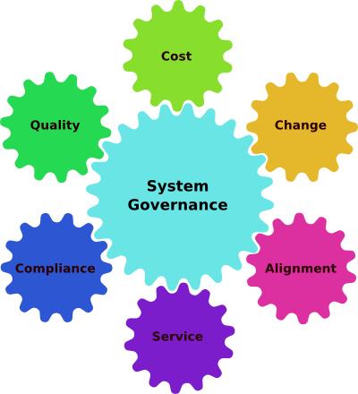
Software Defects
Organizational factors
Inefficient communication
Unclearly defined requirements
Environmental conditions
Radiation, Magnetism, Electronic fields, Pollution, Etc.
These can change the hardware conditions

Slide 16


Software Defects
Anomaly
Error
Bug
Defect
Fault
Problem
Failure
Defect/fault masking

Slide 17

Bug Fixing Importance

Slide 18

Bug Fixing importance (2)

Slide 19

Bug Fixing Importance (3)
Unfixed bugs camouflage other bugs
Suggest quality isn’t important
Duplicate effort
Unreliable metrics and money loss
Fixing a bug today costs less than tomorrow

Slide 20

Bug Fixing Importance
What Is Testing?

Slide 21
What Is Testing?
The process of exercising software
To verify that it satisfies specified requirements and to detect errors
The process of analyzing a software item
To detect the differences between existing and required conditions (that is, bugs)
To evaluate the features of the software item

Slide 22

What Is Testing?
The process of operating a system or component under specified conditions
Observing or recording the results
Making an evaluation of some aspect of the system or component

Slide 23
Main Test Activities
Testing is not just running tests, but also:
Planning and control
Choosing test conditions
Designing and executing test cases
Checking results
Evaluating exit criteria
Reporting on the testing process and system under test
Finalizing or completing closure activities

Slide 24
Main Test Objectives
Testing pursues several objectives:
Finding defects
Gaining confidence about the level of quality
Providing information for decision-making
Preventing defects

Slide 25
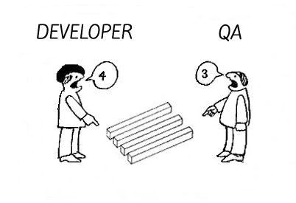
QA vs Devs
QA testers
Are perceived as destructive – only happy when they are finding faults!
Usually require good communication skills, tact & diplomacy.
Normally need to be multi-talented (technical, testing, team skills).

Slide 26
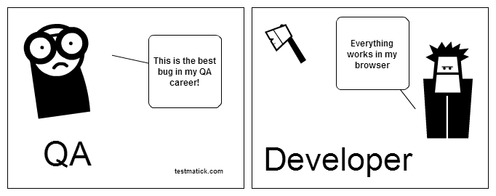
QA vs Devs
Developers
Are perceived as very creative – they write code without which there would be no system
Are rarely good communicators
Can often specialize in just one or two skills (e.g. VB ,C++,JAVA,SQL)

Slide 27
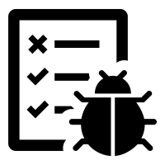
Seven Testing Principles
Testing shows presence of defects
Testing can show that defects are present
Cannot prove that there are no defects
Appropriate testing reduces the probability for defects

Slide 28

Seven Testing Principles (2)
Exhaustive testing is impossible
All combinations of inputs and preconditions are usually almost infinite number
Testing everything is not feasible
Risk analysis and priorities should be used to focus testing efforts

Slide 29
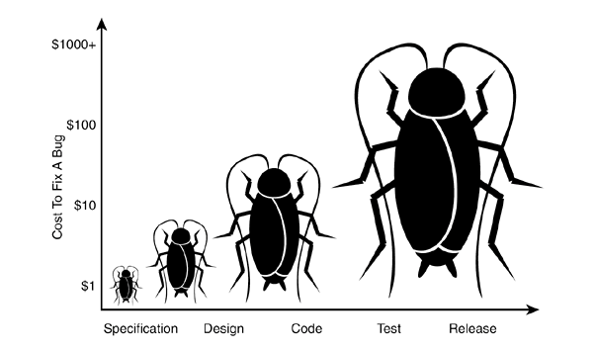
Seven Testing Principles (3)
Early testing
Testing activities shall be started as early as possible
And shall be focused on defined objectives
The later a bug is found – the more it costs!

Slide 30
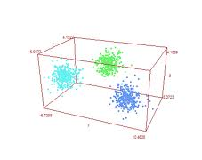
Seven Testing Principles (4)
Defect clustering
Testing effort shall be focused proportionally
To the expected and later observed defect density of modules
A small number of modules usually contains most of the defects discovered

Slide 31

Seven Testing Principles (5)
Pesticide paradox
Same tests repeated over and over again tend to loose their effectiveness
Previously undetected defects remain undiscovered
New and modified test cases should be developed

Slide 32
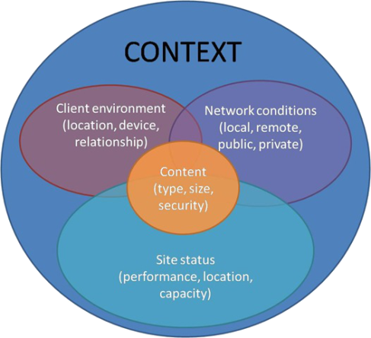
Seven Testing Principles (6)
Testing is context dependent
Testing is done differently in different contexts
Safety-critical software is tested differently from an e-commerce site

Slide 33

Seven Testing Principles (7)
Absence-of-errors fallacy
Finding and fixing defects itself does not help in these cases:
The system built is unusable
Does not fulfill the users needs and expectations

Slide 34

Summary
Software evolved through the time
Retail, web, mobile
It still has bugs
Reasons does not change
Importance of fixing bugs
More Customers
More money
No unsatisfied developers
…
…
…

Slide 35

Literature
QA Book: www.istqb.org/downloads/send/2-foundation-level-documents/3-foundation-level-syllabus-2011.html4
Tutorials: www.w3schools.com
Selenium: leanpub.com/selenium-webdriver-book
GitHub: github.com/QualityAssuranceTeam/source
More Tutorials: www.codecademy.com

Slide 36
https://softuni.bg/courses/technology-fundamentals

Slide 37













SoftUni Diamond Partners

Slide 38





SoftUni Organizational Partners

Slide 39




Trainings @ Software University (SoftUni)
Software University – High-Quality Education and Employment Opportunities
softuni.bg
Software University Foundation
http://softuni.foundation/
Software University @ Facebook
facebook.com/SoftwareUniversity
Software University Forums
forum.softuni.bg

Slide 40

License
This course (slides, examples, demos, videos, homework, etc.) is licensed under the "Creative Commons Attribution-NonCommercial-ShareAlike 4.0 International" license

